Slide 1
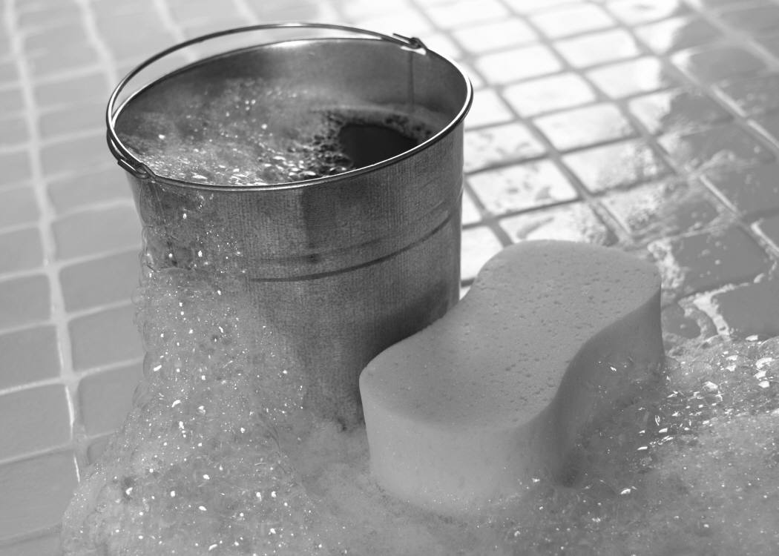
Help Keep A Neighborhood Boy Busy This Summer!
☺
Nathan’s
Car Washing
( That’s Nathan Steiner ☺ )
Any small or medium car - $ 8
Any Truck, SUV or Van - $10
White walls - $4 extra
Included in your service:
Rinse
Mild soap and water wash with sponge
Rinse & Dry
Available anytime!
Ring the doorbell (485 Palomino Drive)
or
Call 443-299-2083

